Slide 1


Sales forecasting for Rossman Drug Store
By: Rahul Singh Pundir
E16CSE075
Final Year Project
Notes:
Add Caption : Expect More

Slide 2
PROBLEM STATEMENT
Sales is one of the most important business domains for data science and data mining applications as it defines the growth and expansion of a business.
If we can predict or forecast sales, then we can stabilize the uncertainty of any business and control its growth and many different factors(like under and over stocking).
For a new startup it can become a source of credibility so that the person can convince investors on investing on their startup based on the sales forecast of a similar or somewhere close business.
Sales forecast also helps the organization to manage the work force required at the store and provides the owner with somewhat predictable outputs.

Slide 3
QUALITY OF PROJECT
The main parameters to judge the quality of my project will be the RMSPE score and the accuracy of the prediction of sales.
As better the accuracy of prediction better is the utilization and acceptance of project.
I would give my project a “8.5” on a scale of 1 to 10.
As the work I did required a lot of research mainly on the XgBoost model and it made me go through various approaches and hence it consumed a lot time but yes, the accuracy I achieved is still good but yes I could have done better if there was no time constraints and deadlines.
Satisfied with my efforts but yes, improvisation is what I would always go for.

Slide 4
TECHNICAL APPROACH
I used Jupyter notebook platform to make my project, while using Python language to code.
To start with the problem statement I analyzed the dataset first looked for the null values and did some exploratory data analysis, I treated the values in the columns of table using one hot encoding and label encoder so that I can process them.
I applied Linear Regression machine learning model to check the accuracy of prediction which was not much but only 55% not even satisfactory.
After doing some background research I opted for Extreme Gradient Boosting (XgBoost) model in which I got a rmspe score of 0.109785 which is way better than what I got using Linear Regression.

Slide 5
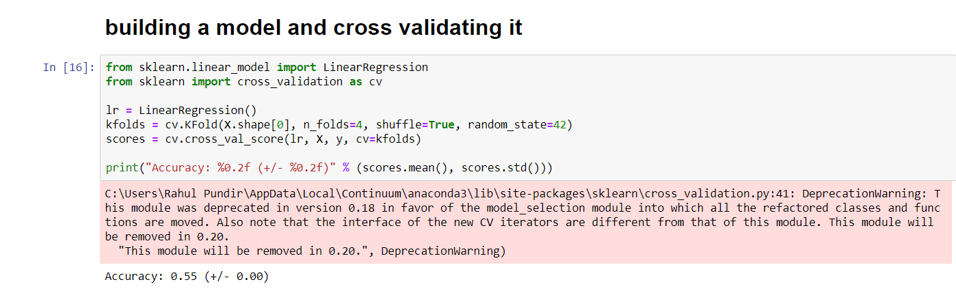
RESULTS OF THE PROJECT
Below attached is the screenshot of the accuracy of Linear regression model.

Slide 6
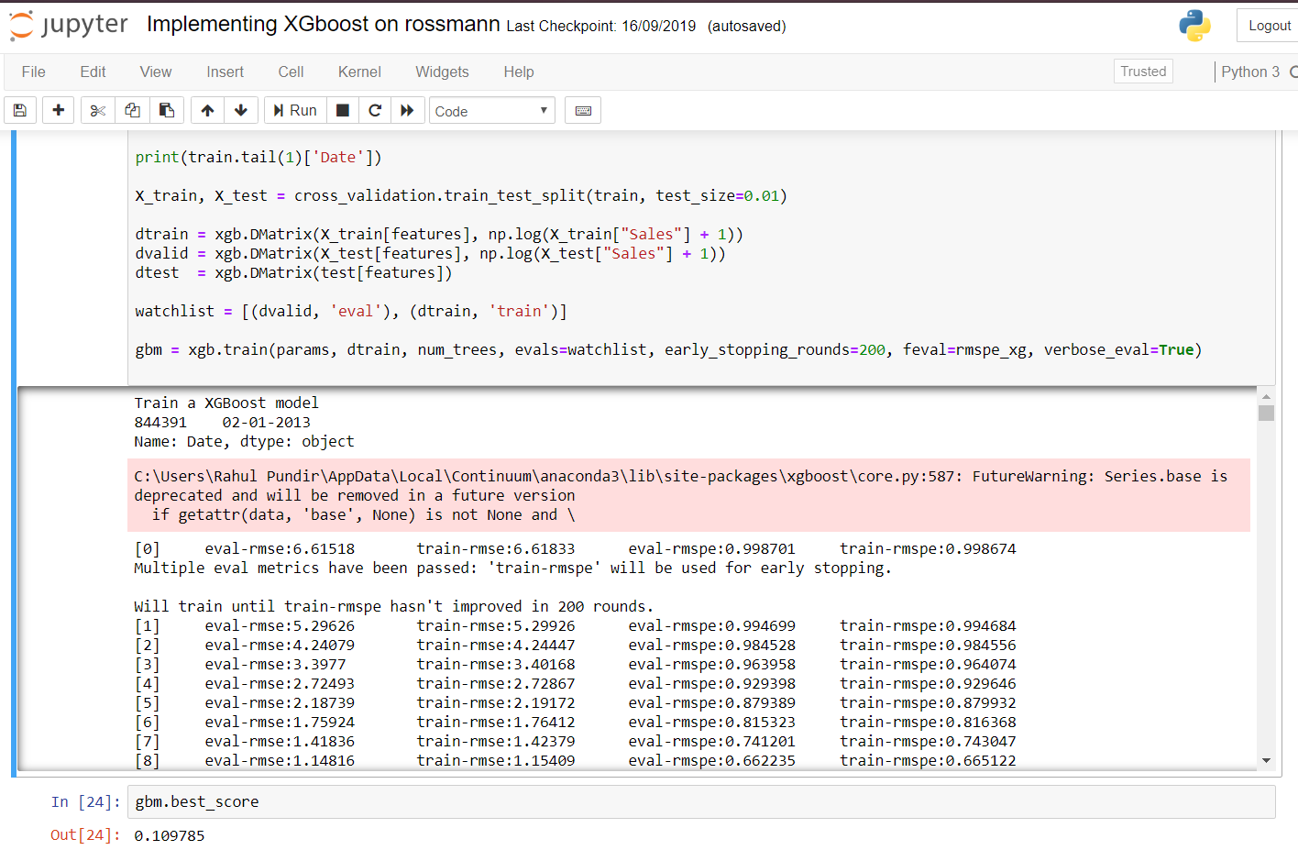
Below attached is the screenshot of the Extreme Gradient Boosting (XgBoost) model RMSPE score.

Slide 7
IMPACT ON INDUSTRY OF THIS PROJECT
The projects usability is the biggest factor as it will directly effect the business growth of an organization and the project is very easy to handle.
This project can provide valuable business insights which helps the company take important sales related decisions quickly hence saving a lot of time and money.
Forecasting helps public companies when setting projections for the next quarter. Meeting the predefined goal from the start of the quarter can have a positive impact on stock prices and investor perceptions.
It also helps marketing people in creating marketing strategies accordingly.

Slide 8


